Slide 1
Java Game Project
Ramon Pena

Slide 2
Questions
The theme of my game is Perseverance and some violence
The goal of the player is to track down and defeat a golden armored knight who stole his Rice Krispies.
My game will be side view
There will be some obstacles that the player will have to jump over, some may or may not move. Type of obstacles will include rocks, bolders, death pits, spikes.
No puzzle to solve.
The game will be mainly cinematic – the player will see things happen then they must take action accordingly.
The player will need to know how to use the arrow keys to jump and move and right mouse click to fight.
Also there will be an automated sprite that tells the player what to do and where to go.

Slide 3
Opening
Game opens with a black screen and two sprites: You(the player) and a golden knight.
In this scene the knight wants to steal all the world’s rice krispies, which starts with him taking yours.
He knocks you out – represented by the screen/background going completely black

Slide 4
The Awakening
You’re awaken several days later by a young woman sprite who healed your wounds and nursed you back to health
She explains what has transpired while you were knocked out
She gives you a sword and tells you where to find the knight and how to defeat him
She gives you a sword and you’re off
This is also where she explains the controls to the player

Slide 5
The Journey
Not really a journey, seeing as it will be pretty linear, just a set path
Here the player will see more sprites in the background, just wondering about. The player will not be able to interact with them.
As the player will encounter bolders, downed trees in order to continue.
They will also encounter an enemy sprite that they will have to defeat to pass(sort of)

Slide 6
Boss Battle
The anticlimactic easiest boss battle in history.
The player will need to parkour over a couple spikes and death pits in order to reach the knight
Once defeated the player will be awarded his Rice Krispies
Player gets Game completed picture.
I have included a picture of how it should look like using pictures I meshed together.

Slide 7
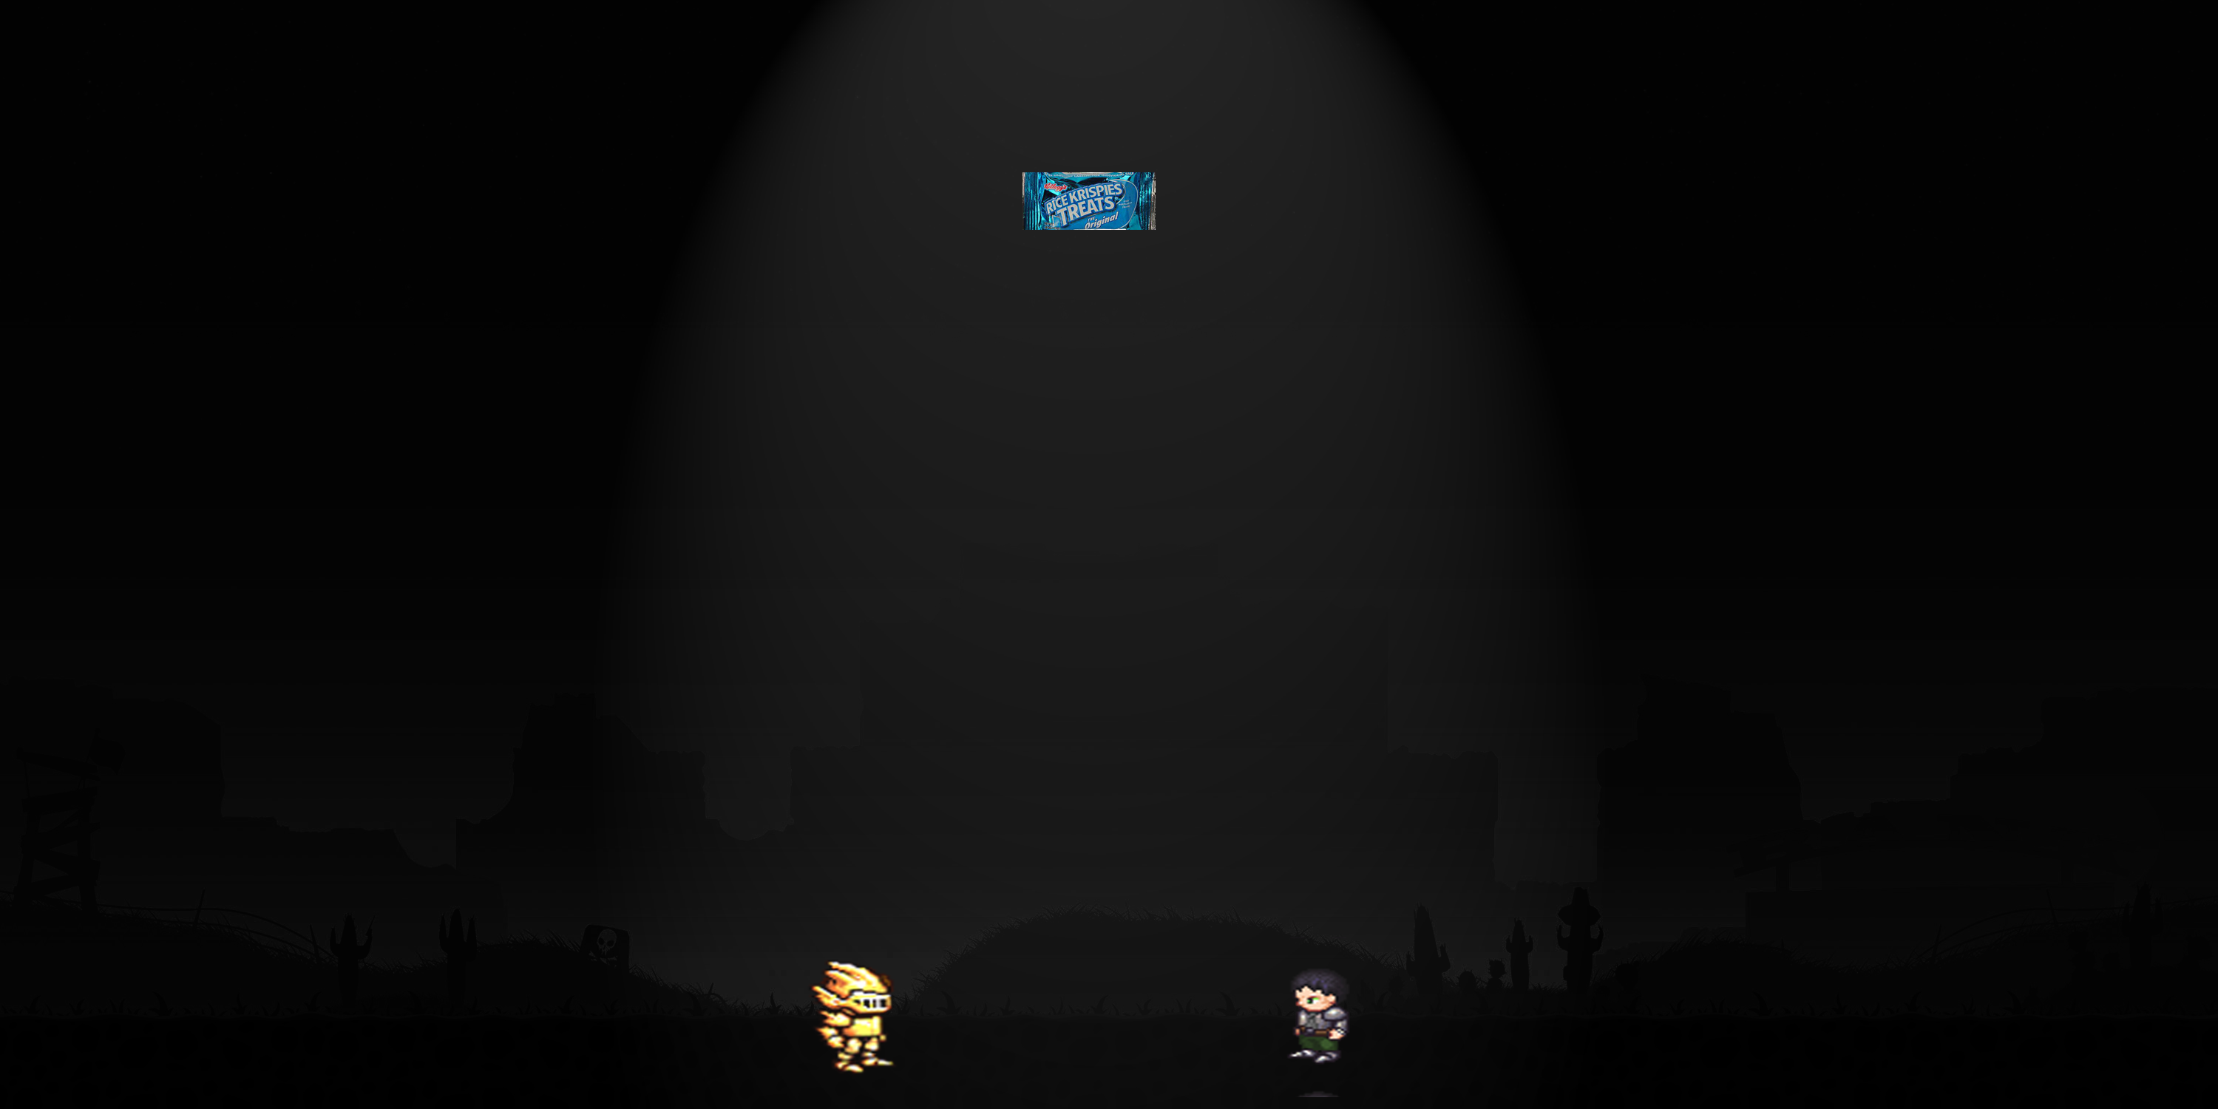
Opening Image – Rice Krispy descending down
Armored Knight - left
Player Character(You) – right

